Slide 1
Document Similarity based Search using Tensorflow Models & ElasticSearch
Vidya Srikanth

Slide 2
OVERVIEW
Problem Statement & Approach
Embedding Models
Computing Document Similarity
Demo SetupData Preparation & Processing
Conclusion

Slide 3
PROBLEM STATEMENT AND APPROACH
Current Use Case:
Query which responses (called “documents”) and what sections of such responses have phrases or sentences (called “query”) that cover the test criteria as outlined in testing standards requirements to produce a match (or coverage) score for each response?
Approach:
Document Similarity Search:
Naive approach ranks documents based on how many words they share with query
More robust approach accounts for syntax and semantic content
Natural language processing (NLP) community uses techniques called “text embedding”
Convert or encode text (words or sentences) as numeric vectors
Capture “linguistic content” and better assess similarity between a query and a set of documents
Demo will cover how we can use Google’s TensorFlow model called Universal Sentence Encoder (USE) to create text embeddings and use robust Elasticsearch platform to support similarity search

Slide 4
Embedding Models
Word embedding model represents a word as a dense numeric vector to capture semantic properties of the word using large corpus of text (such as Wikipedia or Common Crawl)
Words whose vectors are close together should be similar in terms of semantic meaning.
Context each word appears in determines its vector representation
Examples include word2vec (uses neural network prediction) and GloVe (word co-occurrence models)
Sentence embedding models use complex neural network architectures to capture semantic information for longer text segments (sentences, phrases, short paragraphs)
Models convert sentence to produce vectors for each word and entire sentence
Pre-trained models are available from variety of sources
Examples: InferSent, Universal Sentence Encoder, ELMo, and BERT

Slide 5
Embedding Models
Traditional index searches treat each words in the vocabulary as a dimension of vector
Match score computed based on number of times each term in the vocabulary appears in documents without considering sentence structure (called "bag of words")
Results in a very sparse matrix (Lots of zeros) and high dimensional space
Text embeddings map words/sentences to a dense and relatively low-dimensional (100-1000 dimensions) for modeling its semantic meaning
Synonymous words and phrases end up with as similar vectors representation
Sentence embeddings can account for word order when determining the vector representation and commonly used to represent text less than a short paragraph

Slide 6
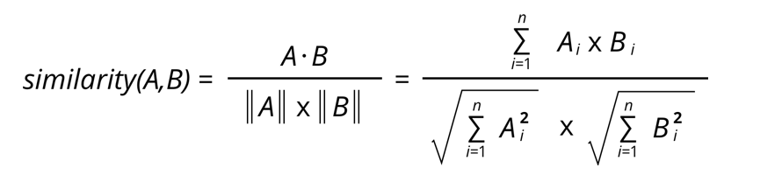
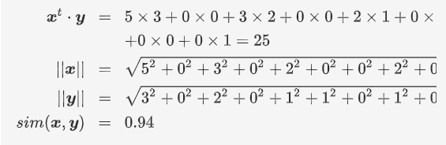
Demo Data and Flow
Corpus of ~20K posts of questions and their answers from Stackoverflow
User asks a question and system retrieves the most similar question in order to help them find an answer quickly
Indexing and text embeddings to the rescue to allow for retrieving similar questions!
Index all posts in ElasticSearch but during indexing we run the title and body text through a sentence embedding model to produce a numeric vector!
User enters a query that uses the same sentence embedding model to produce a vector.
To rank the responses, we calculate the vector similarity between each question and the query vector!
When comparing embedding vectors, we use cosine similarity metric (which computes the cosine of the angle between the embedding vectors, value ranges from -1.0 to +1.0)
Suppose x, y are the encoding vectors for document and query:
x=[5, 0, 3 ,0, 2, 0, 0, 2, 0, 0]
y=[3, 0, 2, 0, 1, 1, 0, 1, 0, 1]
x & y are very similar because similarity metric is very close to 1!

Slide 7
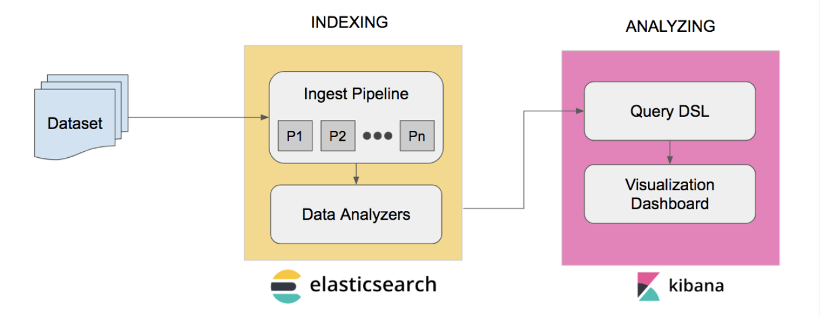
DEMO DATASETS & FLOW
Example of indexed document in Elasticsearch:
{
"_index" : "stack_overflow_q_and_a",
"_type" : "_doc",
"_id" : "vrpCHXQBvI6XCcWL0gj5",
"_score" : null,
"_source" : {
"user" : "17766",
"tags" : [
"database",
"database-design"
],
"questionId" : "158392",
"creationDate" : "2008-10-01T16:10:15.770",
"title" : "Primary Key versus Unique Constraint?",
"acceptedAnswerId" : "158432",
"type" : "question",
"body" : "I'm currently designing a brand new database. In school, we always learned to put a primary key in each table. I read a lot of articles/ discussions/ newsgroups posts saying that it's better to use unique constraint (aka unique index for some db) instead of PK. What's your point of view? ",
"title_vector" : [
0.03238431364297867,
-0.028896398842334747,
-0.030291272327303886,
-0.0491764172911644,
...
0.016004957258701324
]
}
Stackoverflow ~18K posts with Q&A in json format
Both title and body text fields in each post used to used to create the text embedding vector
Create a 3 node ElasticSearch + 1 node Kibana cluster using docker-compose
Python app to index and query
Downloads the USE model from TensorFlow
Loads USE model in memory
Indexes all 18K posts with mappings specified
Compute embedding vector for each post (document) as it is being indexed
Run free text query to find best match to similar questions in corpus of posts!

Slide 8
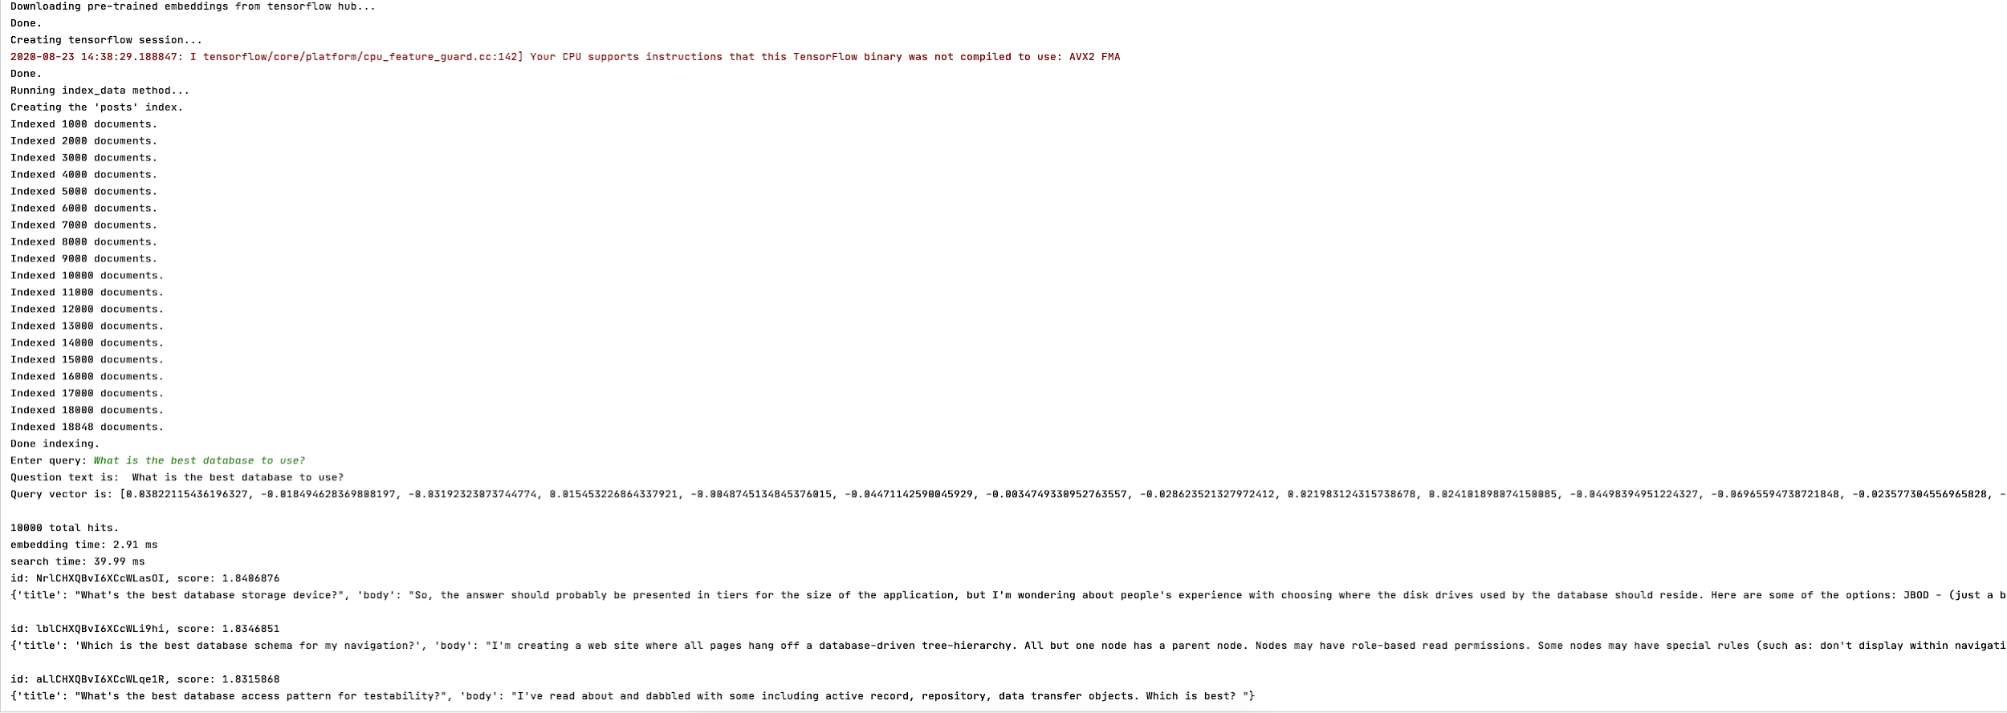
DEMO
Run ElasticSearch in Docker Containers
Index documents in ElasticSearch and compute sentence embeddings for each title and body
Match score = 1 + (cosine similarity score)

Slide 9
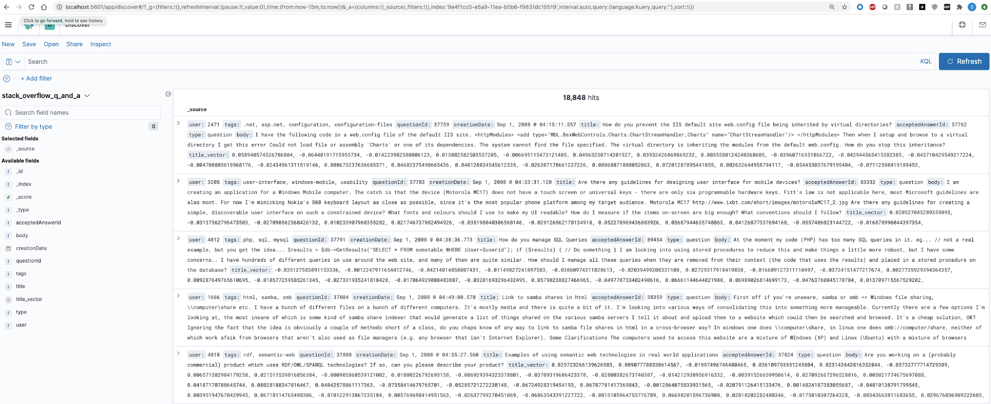
DEMO
Indexed documents in ElasticSearch with sentence embeddings for each document

Slide 10
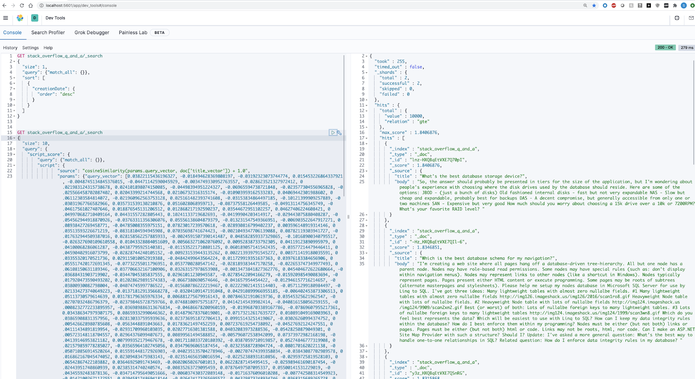
DEMO
Querying indexed documents in ElasticSearch with sentence embeddings for query

Slide 11
KEY INSIGHTS
ElasticSearch provides scalable search and indexing with ability to include ML/NLP plugins for future needs
Kibana which is part of elastic stack can be used to provide visualizations and dashboards for e.g. summaries and aggregates of indexed data
Linguistic context of query text can be handled well Google’s TensorFlow based encoding schemes
Using ElasticSearch and NLP text encoding models we can perform efficient searches and compute match scores efficiently for each response against queries
Using document similarity process, responses from <test requirements> can be matched to determine a score

